Slide 1
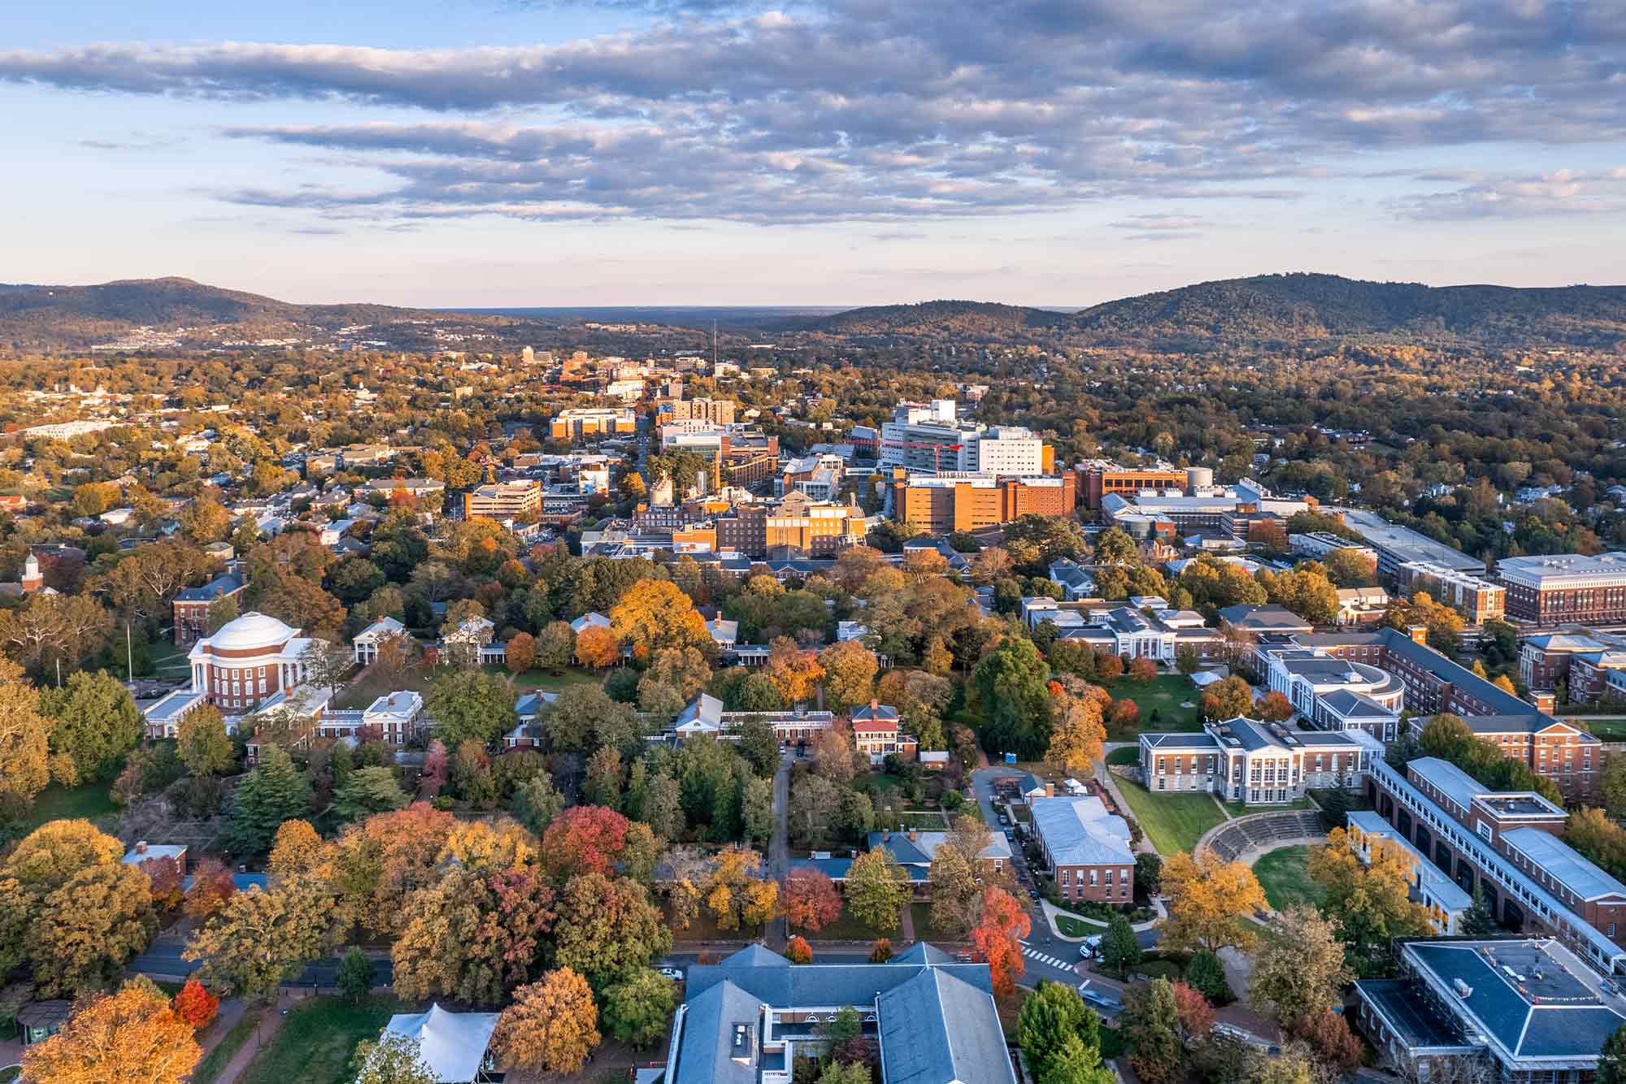
Underdevelopment Despite Upzoning Richard Schragger and Sarah New University of Virginia School of Law
1

Slide 2
Is restrictive zoning a constraint on housing supply? Will lifting restrictions (upzoning) increase supply and decrease cost?
This study looks at the effects of zoning in a small, high demand city: Charlottesville, VA
How important is zoning to a landowner’s decision to develop? One way to answer is to determine whether a city is fully developed under existing land use rules.
Recent literature on the effects of upzoning: Compare Freemark (2023) with Been, Ellen & O’Regan (2023); see also Stacy, et al. (2023) and Molloy, et al. (2023) on upzoning and affordability.

Slide 3
Charlottesville Background
Charlotteville City & surrounding Albemarle County:
Size: 10 square miles & 726 square miles.
Population: 45,373 & 114,532.
The central Virginia region, nine counties, has a population of about 360,000.
Significant multi-decade rise in housing costs in both jurisdictions.
Zoning Ordinance: Based on 2003 and 2008 revisions
Includes creation of Mixed-Use areas, University Districts, and the expansion of Entrance Corridors to provide for more density
14 zoning categories
Zoning code has been in place for at least 15-20 years
2021 zoning plan (codified in 2024) adopted additional upzonings, including the effective elimination of single-family zones

Slide 4
Current State of Development in Charlottesville
Are the city’s residential zones “maxed out”? High levels of unused potential may indicate that restrictive zoning is not the primary constraint on land development.
Our focus here is on “underdevelopment”—the existence of underutilized parcels across residentially zoned parts of the city.
We have identified four distinct types of underdevelopment:
1. Vacant parcels
2. Oversized parcels (i.e., subdividable parcels)
3. Underused parcels (i.e., parcels with fewer dwellings than code allows)
4. Lack of ADU uptake (i.e., failure to construct accessory dwelling units)
The following analysis is based on data sets from Charlottesville’s Open Data portal.

Slide 5
Parcels Zoned Residential
Zoning | Acreage | Parcels | Buildings | Residential Addresses (Dwelling Units)
Single Family | 2340.17 | 8058 | 7762 | 8676
Two Family | 465.45 | 2164 | 1832 | 2701
Multi Family | 293.86 | 1477 | 782 | 4772
Total | 3,099.48 | 11,699 | 10,376 | 16,149
For these calculations, we removed parcels zoned as 'Civic' or 'Campus' in the Draft Zoning plan. This eliminates large public parks, graveyards, and school grounds that might skew our underdevelopment estimates.
Notes:
Data sets used: Parcel Area Details, Master Address Table, Existing Structure Data from July 2023.

Slide 6
West Main Mixed-Use Corridor
Zoning Code | Acreage | Parcels | Buildings | Total Addresses | Residential Addresses
WME | 0.84 | 8 | 6 | 9 | 9
WMEH | 17.18 | 58 | 50 | 181 | 86
WMW | 0.29 | 3 | 1 | 1 | 1
WMWH | 11.79 | 20 | 16 | 467 | 435
Total | 30.1 | 89 | 73 | 658 | 531
Notes:
There are other mixed use corridor zones that allow residential not included in this analysis.

Slide 7
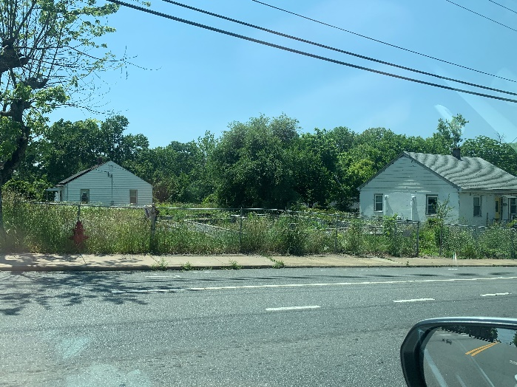
Types of Underdevelopment – Vacant Parcels
Vacant Parcels in Residential Zoning Districts
Zoning | Parcels | Vacant Parcels | Vacant Acreage
Single Family | 8,058 | 328 | 88.84
Two-Family | 2,164 | 104 | 29.20
Multi-Family | 1,477 | 47 | 27.41
Total | 11,699 | 479 | 145.45
Upper-Limit Possibilities of Vacant Land Development
Zoning | Vacant Parcels | Dwelling Units Allowed in Current Configuration | Potential Lots Made from Vacant Acreage | Dwelling Units Possible on Potential Lots
Single Family | 328 | 328 | 586 | 586
Two-Family | 104 | 208 | 634 | 634
Multi-Family | 47 | 556 | 596 | 596
Total | 479 | 1,092 | 1,816 | 1,816
Vacant Corner Lot
Notes:
Ran an intersect on parcels and structures – these are parcels with no structure polygons intersecting them.
Upper Limit = imagine flat, contiguous land that we can subdivide in such a way that meets all other City requirements like frontage, setbacks, etc. For 2-family and multi-family, we’re making smallest possible lots – townhome or single family attached.
But for multifamily, you can achieve more density by not subdividing. City code allows 21-64 dwelling units per acre for various multi-family zoning codes.

Slide 8
Vacant Parcels – Mixed Use Corridor
 | Parcels | Vacant Parcels | Vacant Acreage | Dwelling Units Allowed | Potential Lots if Subdivided
West Main East | 66 | 6 | .73 | 31 | 15
West Main West | 23 | 6 | 1.24 | 79 | 27
Total | 89 | 12 | 1.97 | 110 | 42

Slide 9
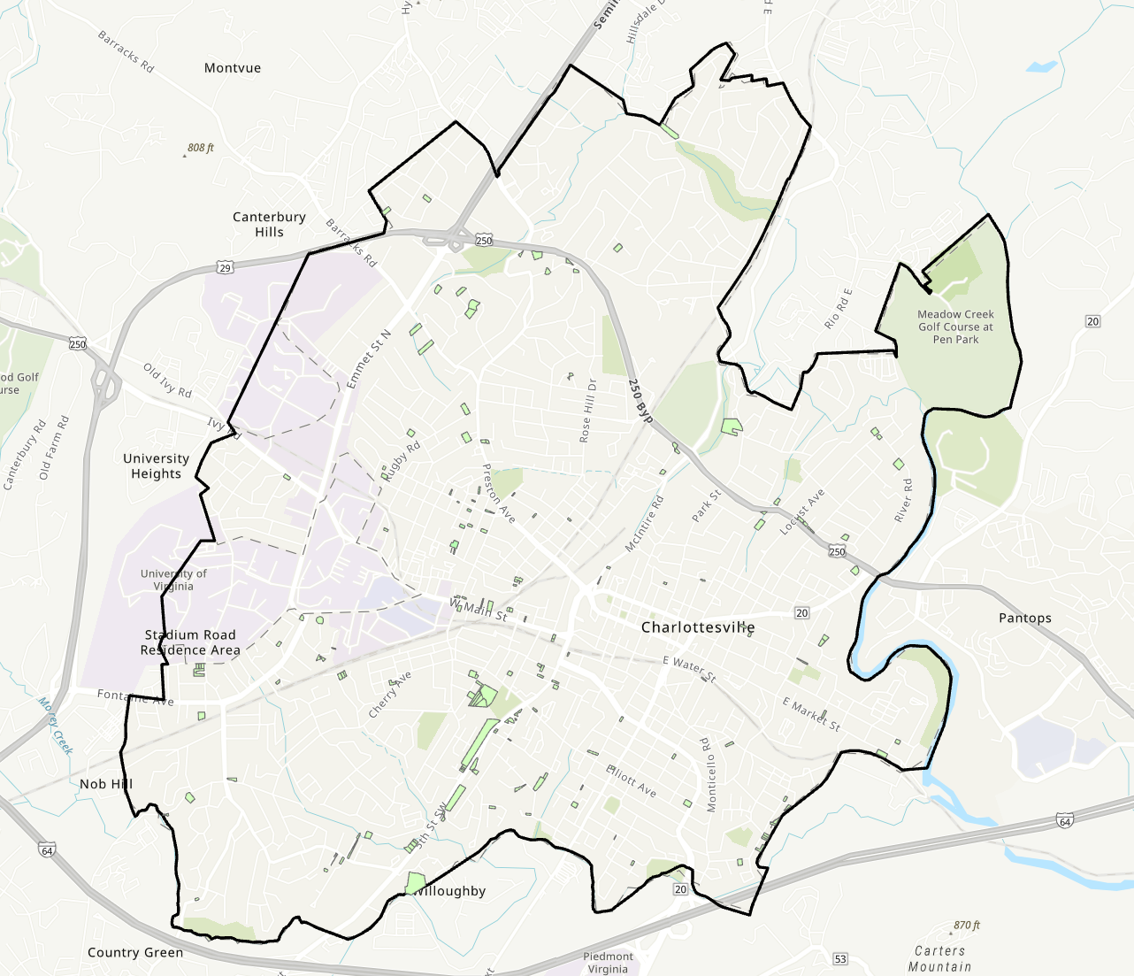
Vacant Parcels

Slide 10
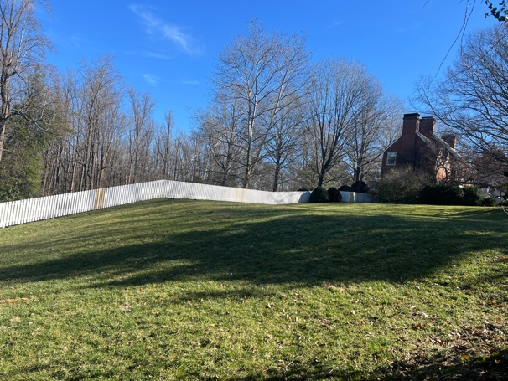
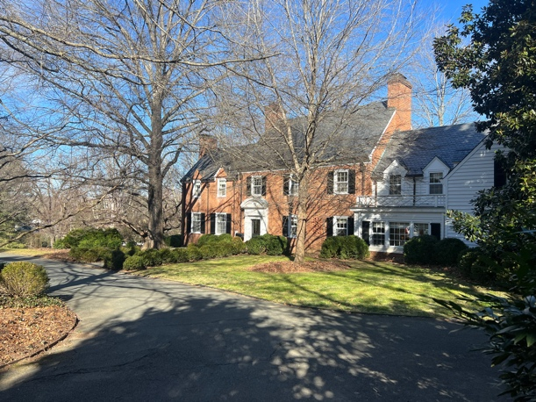
Types of Underdevelopment – Large Parcels
Oversized Parcels in Residential Zoning Districts
Zoning Code | Parcels | Parcels > 2 Lots | % Parcels > 2 Lots | Potential Additional Dwelling Units
Single Family | 8,058 | 1,896 | 23.53% | 1,896
Two-Family | 2,164 | 1,891 | 87.38% | 1,891
Total | 10,222 | 3,787 | 37.05% | 3,787
Ripe for Subdivision Parcels in Residential Zoning Districts
Zoning Code | Parcels | Parcels > 2 Single Family Lots | Ripe for Subdivision Parcels | Ripe for Subdivision Acreage
Single Family | 8,058 | 1,896 | 1,497 | 881.2
Two-Family | 2,164 | 371 | 174 | 75.44
Total | 10,222 | 2,267 | 1,671 | 956.64
4 acre parcel zoned R-1U
Notes:
Some of these lots are much larger than double the minimum size. This 4 acre lot is an example; at the min single family lot size (8,125 sq ft), that land could fit 20 homes.
Analysis based only on lot size implies that we’d be knocking down existing homes. But what about current homeowners as rational economic actors? If I’m a homeowner with a large lot, I wouldn’t want to knock down my own home. But I might be willing to split off and sell some of my land.
Unique BINs -> bigger than 2x minimum lot -> building placement

Slide 11
Impact of Additional Requirements on Subdivision of Large Parcels
We recognize that the city’s additional requirements for lots could affect the number of these “Ripe for Subdivision” parcels that could be developed.
We chose one such requirement to see how significant the impact might be: frontage.
Charlottesville requires 50 feet of road frontage for single family homes (with some exceptions for cul-de-sacs).
Zoning Code | Ripe for Subdivision Parcels | RfS Parcels with >100ft of Frontage | % RfS Parcels with >100ft of Frontage
Single Family | 1497 | 840 | 56.11%
Two-Family | 174 | 57 | 32.76%
Total | 1,671 | 897 | 53.68%
Notes:
Road centerlines -> buffer. Split polygons -> line centroids. Intersect buffer and centroids. Delete all that don’t intersect. Delete stray segments. Calculate length, then sum and join back to associated parcel.
Those 897 parcels represent AT LEAST another 897 homes.

Slide 12
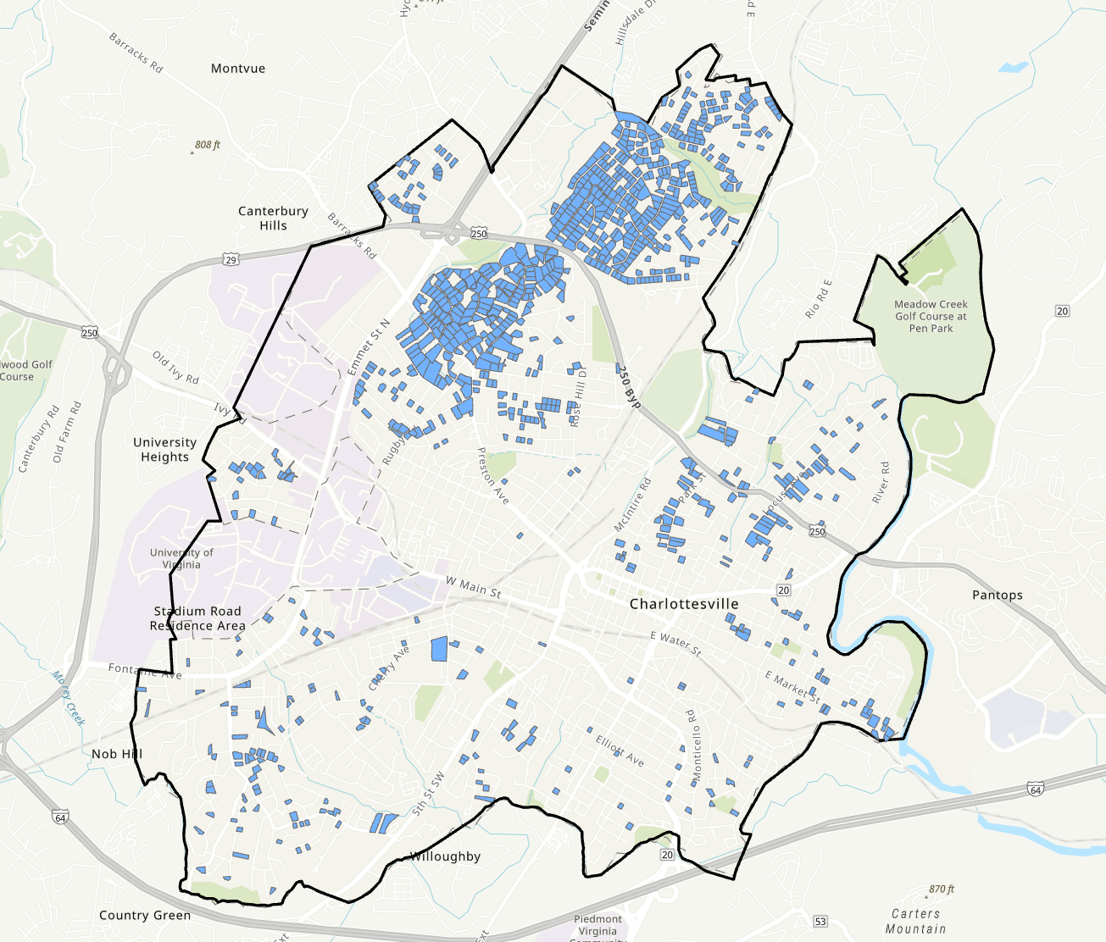
Ripe for Subdivision parcels with at least 100 ft of frontage
Notes:
Concentrated in the Greenbrier and Barracks neighborhoods.
Is the reason these homeowners aren’t subdividing historic protection or architectural control? I checked.

Slide 13
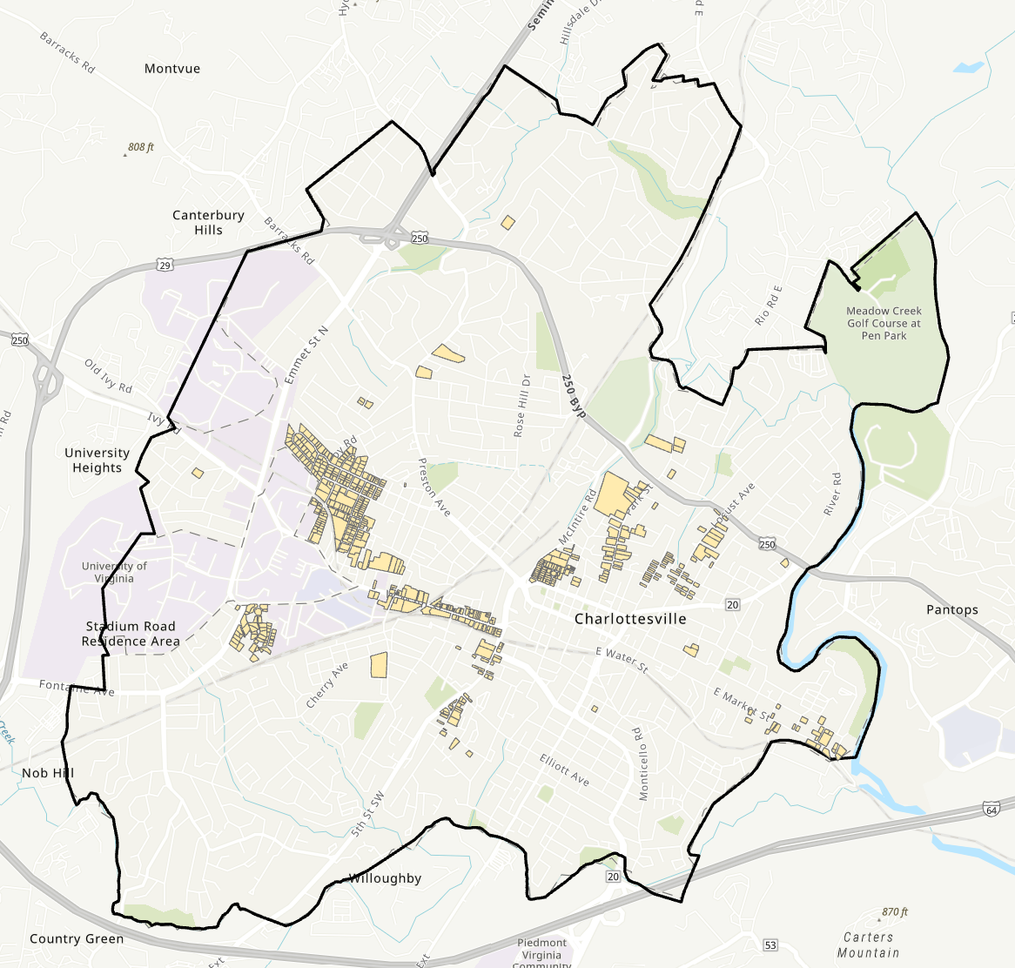
Parcels with Historical Preservation and Architectural Design Control Overlay
Notes:
Little overlap with the RfS parcels – a few to the east.

Slide 14
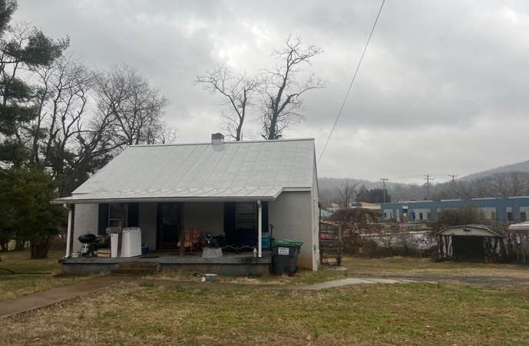
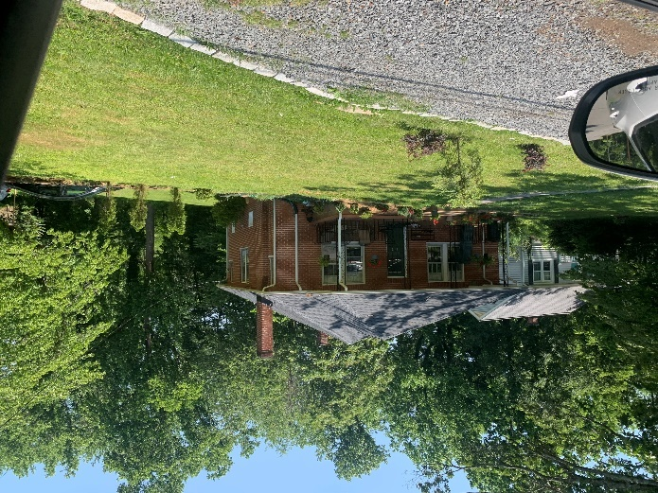
Types of Underdevelopment – Underbuilt Parcels
Underused Parcels in Residential Zoning Districts
Zoning | Parcels | Buildings | Residential Addresses | Dwelling Units Allowed | % Developed Under Permitted Uses
Single Family | 8,058 | 7,762 | 8,676 | 8,058 | 107.67%
Two-Family | 2,164 | 1,832 | 2,701 | 4,328 | 62.41%
Multi-Family | 1,477 | 782 | 4,772 | 9,346 | 51.06%
Total | 11,699 | 10,376 | 16,149 | 21,732 | 74.31%
Single family homes built on two-family and multi-family zoned parcels.
Notes:
R-1 overbuilt: 328 vacant parcels, so we expect 7730 homes. More buildings, but maybe some are free-standing garages. But so many addresses! Apartment buildings grandfathered in.

Slide 15
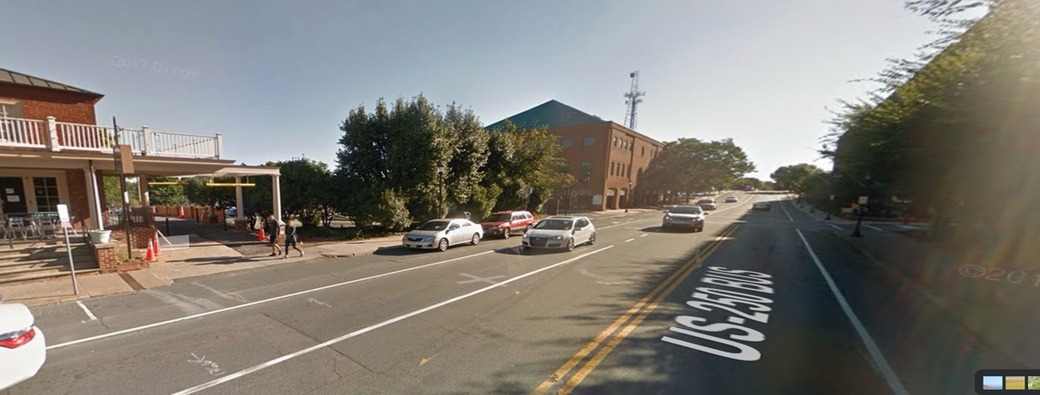
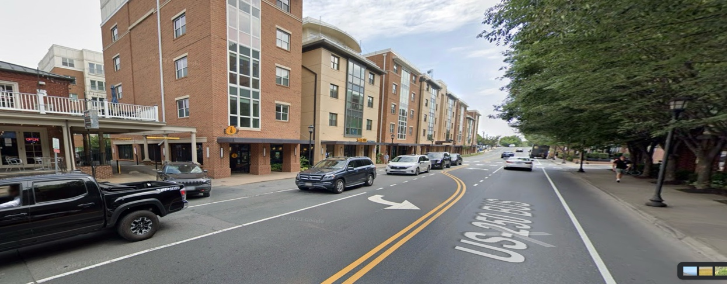
Underbuilt Parcels in Mixed Use Corridors
Underused Parcels in West Main Street Corridors
District | Parcels | Buildings | Total Addresses | Residential Addresses | Dwelling Units Allowed | % Housing Developed Under Permitted Uses
WME | 66 | 56 | 190 | 95 | 774 | 12.27%
WMW | 23 | 17 | 468 | 436 | 773 | 56.40%
Total | 89 | 73 | 658 | 531 | 1,547 | 34.32%
West Main St, 2016
West Main St, 2023

Slide 16
Types of Underdevelopment – Lack of ADUs
Zoning Code | Probable ADUs | ADUs Allowed by Code | % of Allowed ADUs Built
MR | 0 | 182 | 0%
R-1 | 41 | 2,709 | 1.51%
R-1S | 139 | 4,646 | 2.99%
R-2 | 55 | 1,803 | 3.05%
R-3 | 3 | 676 | 0.44%
R-UMD | 0 | 478 | 0%
R-UHD | 0 | 141 | 0%
Total | 238 | 10,635 | 2.24%
Accessory Dwelling Units
The property owner must live on-site in either the primary house or the accessory unit.
Must be authorized by a provisional use permit
Notes:
I identified all parcels with 2 street addresses, then checked whether the parcel owner’s address matched the street address. If so, I counted 1 probable ADU.

Slide 17
Conclusion: Residential zones are underbuilt as of July 2023, under the then-existing zoning regime.
Vacant parcels: 4% of parcels are vacant
Oversized parcels: 37% of lots are more than twice the minimum size
Underbuilt parcels:
Two-family and multi-family residential parcels are only 54.6% developed
Mixed use corridor has 34% of permitted housing
Lack of ADU uptake: only 2% of parcels with the option to build ADUs have done so
Why underdevelopment?
Existing zoning/other regulations were still too restrictive?
Geographic constraints?
Preferences of existing landowners; market/developer preferences?
Macro-economic conditions, cost of labor/construction, developer financing?
Other?
Notes:
Vacant parcels could be 1,000 new homes in current configuration.
Oversized: if only half of Ripe for Subdivision lots were subdivided, we would add 450 new homes.
Underbuilt: We are using multifamily zones like single family zones. These are only half built and could represent 6,000 more homes.
ADUs: City code allows 10,635 parcels to build ADUs (subject to permit process). Only 2% of those have exercised the option.

Slide 18
Potential implications for Charlottesville’s recent upzoning, which eliminated single-family zones.
Did previous zoning regime “handcuff” landowners, by preventing development that would otherwise take place, thus justifying upzoning?
Lack of uptake even with upzoning is predicted. The city’s consultants concluded that “[o]f the more than 10,000 parcels in the study area, less than 2% would turn over and be market viable for redevelopment. Of this subset, an even smaller portion is likely to be redeveloped.”
Charlottesville’s goal of providing “missing middle” housing—duplexes and townhomes—may be achieved on a relatively small scale. The city’s upzoning, which only affects a very small portion of the regional housing market, seems unlikely to decrease regional housing costs.

Slide 19
Takeaways
Land use under the current zoning is not being fully exploited and our prediction that future zoning will have limited uptake should mute the more extravagant claims made by both proponents and opponents of Charlottesville upzoning.
Multi-family zones in Charlottesville are being used as single-family zones, which suggests that the elimination of single-family zoning may not have the predicted effects.
This study provides some initial evidence that allowing more density does not necessarily generate it.
That may mean that land use reform interventions need to be larger or better targeted.
Or it may mean that demand side (and other) factors swamp supply side ones, contrary to some conventional wisdom.
Our study is consistent with other studies showing limited up-take and modest price effects of upzonings.

Slide 20
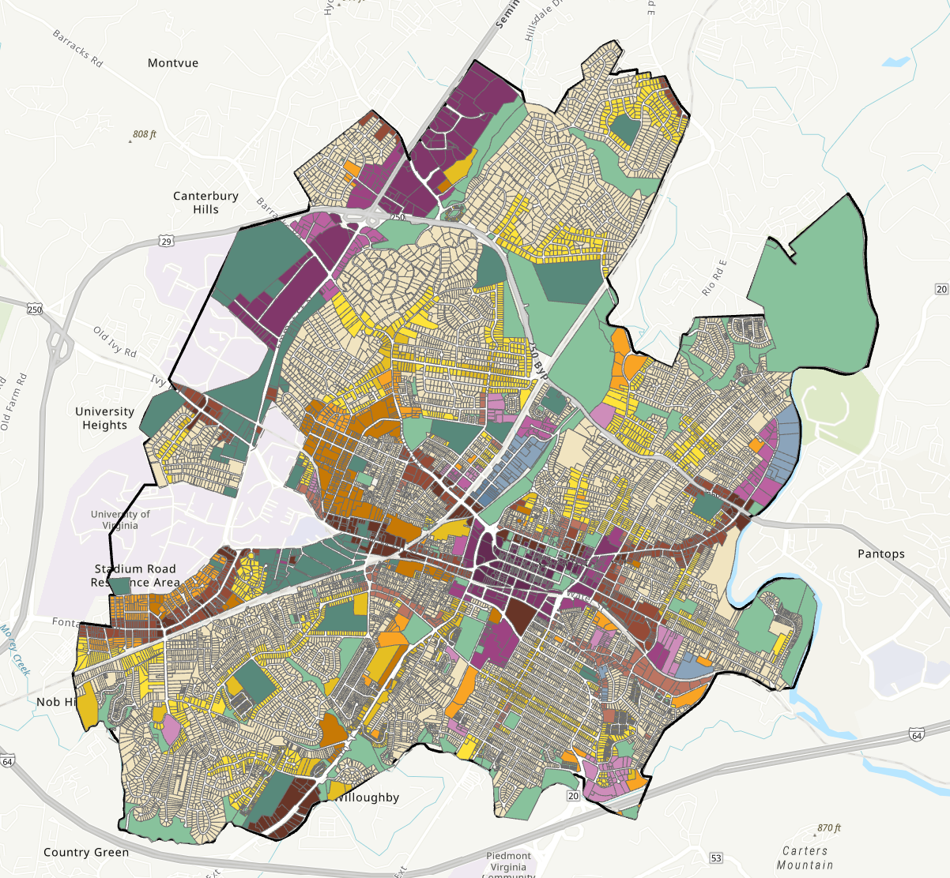
Charlotteville 2024 Proposed Zoning

